Slide 1

STUDENT DETAILS
NAME:CHINTALAPATI VAMSI KRISHNA
ROLL NO:23ME5A4601
EMAIL ID:CHVAMSIKRI@GMAIL.COM
NAME OF THE COLLEGE:RAMACHANDRA COLLEGE OF ENGINEERING
LOCATION:ELURU

Slide 2


Image Steganography: Hiding Secrets
Steganography is the art of hiding information within other data. By embedding secret messages in images, we can secure sensitive data from unauthorized access.
KS

Slide 3

Project Title: Secure Communication Through Images
1
Goal
2
Challenge
3
Objective
Develop a steganographic system that effectively hides text messages within images.
Implement algorithms to embed and extract messages without compromising image quality.
Create a robust, user-friendly tool for secure communication.

Slide 4
Project Agenda: A Step-by-Step Guide
1
Introduction
Project Overview and Background
2
Methods
Explanation of Steganographic Techniques
3
Implementation
Demonstration of the System's Functionality
4
Results
Analysis of the System's Performance
5
Future Directions
Potential Enhancements and Applications

Slide 5


Project Overview: Understanding the Problem
The project focuses on the concept of steganography, where confidential messages are hidden within seemingly innocuous images. This approach aims to enhance communication security by concealing information from unauthorized individuals.

Slide 6


End Users: Who Benefits from Secure Communication?
Individuals
Securing personal communications, privacy protection.
Businesses
Protecting sensitive data, secure internal communication.
Governments
Confidential intelligence sharing, secure communication channels.

Slide 7


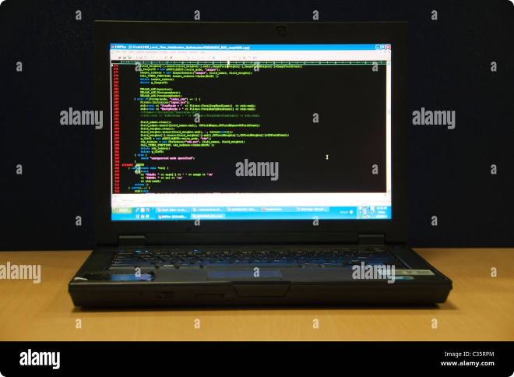



Solution: Our Approach to Secure Messaging
Image Selection
Choosing suitable images for hiding messages.
Message Encoding
Converting text messages into binary code.
Embedding Process
Hiding encoded messages within image pixels.
Extraction Method
Retrieving hidden messages from images.

Slide 8

Customization: Making Our Solution Unique
To personalize our project, we incorporated features like robust encryption for enhanced security. The system is designed to be user-friendly, allowing individuals with limited technical expertise to utilize it effectively.

Slide 9

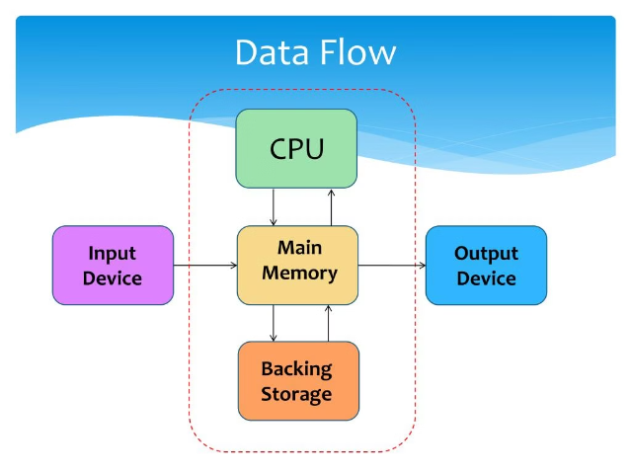
Modeling: The Foundation of Our System
Algorithm
Description
Least Significant Bit (LSB)
Embeds messages by modifying the least significant bits of image pixels.
Error Diffusion
Distributes embedding errors across image pixels, minimizing visual distortion.

Slide 10





Results: Evaluating the System's Success
Reliability
The system consistently embeds and extracts messages without errors.
Security
Encryption ensures the hidden messages remain confidential.
Invisibility
The hidden messages are undetectable by the naked eye.

Slide 11
LINKS

